Slide 1

Facial Recognition with Python, OpenCV and Raspberry Pi
For security against crime tourism

Slide 2

Everybody Loves Recognition

Slide 3
Problem - Crime Tourism
Very different from ‘crime against tourists’ (also a major problem), crime tourism refers to organized gangs that enter countries on tourist visas with the sole intention to commit crime or make a quick buck.
These tourists do not reside in countries for more than a few weeks, they seek to inflict maximum damage on locals before returning to their home countries.
Although crime tourism exists to a certain level in most countries, recent news cycles suggest that Canada, US, Australia have been dealing with an increased level or crime tourism as an organized crime.

Slide 4
Excerpt from Canadian Report
“Over the weekend, we got a notification that there were at least three people arrested,” he said. “And there were two detained yesterday in a different city. It’s just a growing problem.”
When police in Australia broke up a Chilean gang in December, they thanked Canadian police for tipping them off.
Three suspects who’d fled Ontario and returned to Chile turned up in Sydney, Australia.
The tip from Halton Regional Police led to eight arrests and the recovery of more than $1 million worth of stolen goods.

Slide 5
Solution - Recognition
Definition: Identification of someone or something or person from previous encounters or knowledge
This is where FACIAL RECOGNITION comes in! Coordination between response teams can be made much better with real-time facial recognition.

Slide 6
What’s this project?
Simple, portable devices using computer vision can be installed at places like airports and public places to raise a flag if a suspicious person is detected.

Slide 7
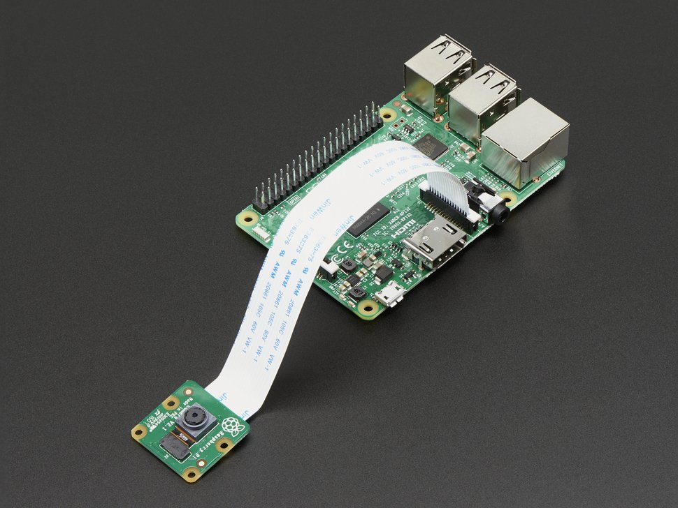
Components and Software
For this project, I used a low-budget solution using a Raspberry Pi ($35), a Pi camera($15) on the hardware side, and OpenCV and Python on the software side.

Slide 8
First step : Configure your Raspberry Pi and install your Pi camera

Slide 9
Second Step: OpenCV compilation – 7 hours https://www.pyimagesearch.com/2019/09/16/install-opencv-4-on-raspberry-pi-4-and-raspbian-buster/

Slide 10
Important Things to Remember
You need to expand your filesystem to be able to use the entire 32GB of Pi memory
You need to create a Python 3 virtual environment and always make sure that you’re working inside that environment
Before you begin the compile process –
Increase the SWAP space from 100 MB to 2048 MB to enable you to compile OpenCV with all four cores of the Raspberry Pi (and without the compile hanging due to memory exhausting).
After installation of NumPy and completion of compilation, reswap to 100MB

Slide 11
Three Simple Python Programs
Face Detection
Train the Recognizer
Real-Time face Recognition

Slide 12
Face Detection Using Haar Cascade Classifier
Object Detection using Haar feature-based cascade classifiers is an effective object detection method proposed by Paul Viola and Michael Jones in their paper, "Rapid Object Detection using a Boosted Cascade of Simple Features" in 2001.
ML based-approach where cascade function is trained from a lot of positive and negative images and then used to detect objects in other images.
Haar Cascades directory available on OpenCv github

Slide 13
This project and all my code is available on my github profile: https://github.com/dilipmerala/

Slide 14
A Big Thank You to
Adrian Rosebrock – PyImagesearch
Marcelo – MjRobot

Slide 15
DEMONSTRATION

